Slide 1


Advances and challenges in a growing collaboration
Nick Draper
Tessella www.mantidproject.org

Slide 2

Project Goals
Goals
Consolidate the data reduction/analysis software for neutron scattering and muon experiments
Without restricting the needs of the instrument scientists
Key requirements
Create a data reduction/analysis framework
not instrument or technique dependent
Cross-platform
Windows, Linux, Mac
Easily extensible
Freely redistributable
Open source
You can see what is going on
Good basis for collaboration

Slide 3




Professional Development
Professional Project Management
Dedicated software engineers
All with science BSc, many with PhD
Source code control in Github
Continuous build and testing
20+ build servers managed through Jenkins
World class static code analysis
Over 8,500 automated unit tests
Almost 300 automated system tests
Comprehensive documentation
Including 675 automated tests on included scripts
Both online and installed with Mantid

Slide 4







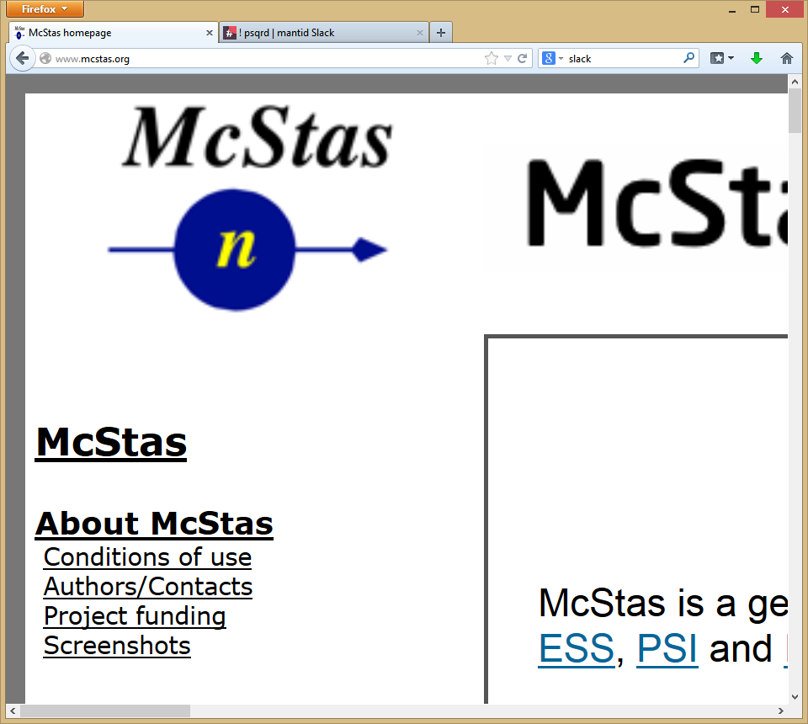
Contributors
Partners
Prime Contractor
Contributors

Slide 5
ISIS
SNS
ESS
Robust framework
Extensible plugin design
Multithreaded performance
Documentation
Training
Automated build, test and deployment
Algorithms
Many algorithms already developed
Event Filtering and data analysis
Improvements to build process
Cmake, Jenkins
Improved python code framework
Autoreduction system
New file formats
NxSPE
Event Nexus
Paraview, Kitware contract, VSI
Live Data Focus
Performance Optimization
More to come …

Slide 6
What we can do: Algorithms
~600
Arithmetic
Correction Functions
Absorption
Background
Efficiency
Data handling
Diagnostics
Calibration
Event Filtering
Optimisation
Transforms
Masking
Grouping
Smoothing
Unit conversions
Technique dependent
Single Crystal
Inelastic
SANS
Powder diffraction

Slide 7
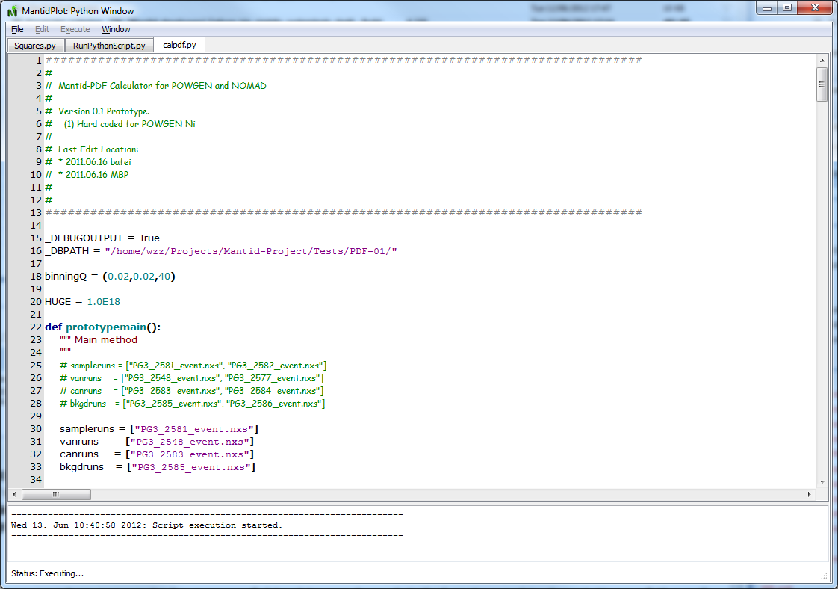
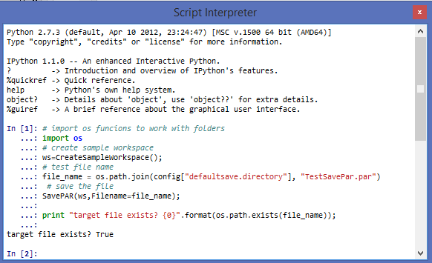
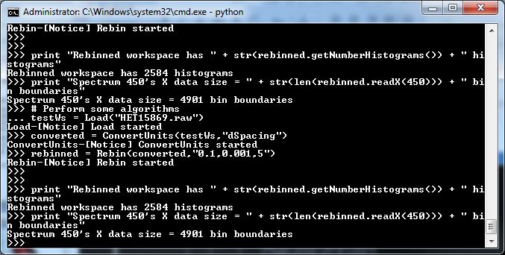
What we can do: Scripting
Scripts using the script window
Interactive via iPython
Can also be controlled direct from Python without a user interface

Slide 8
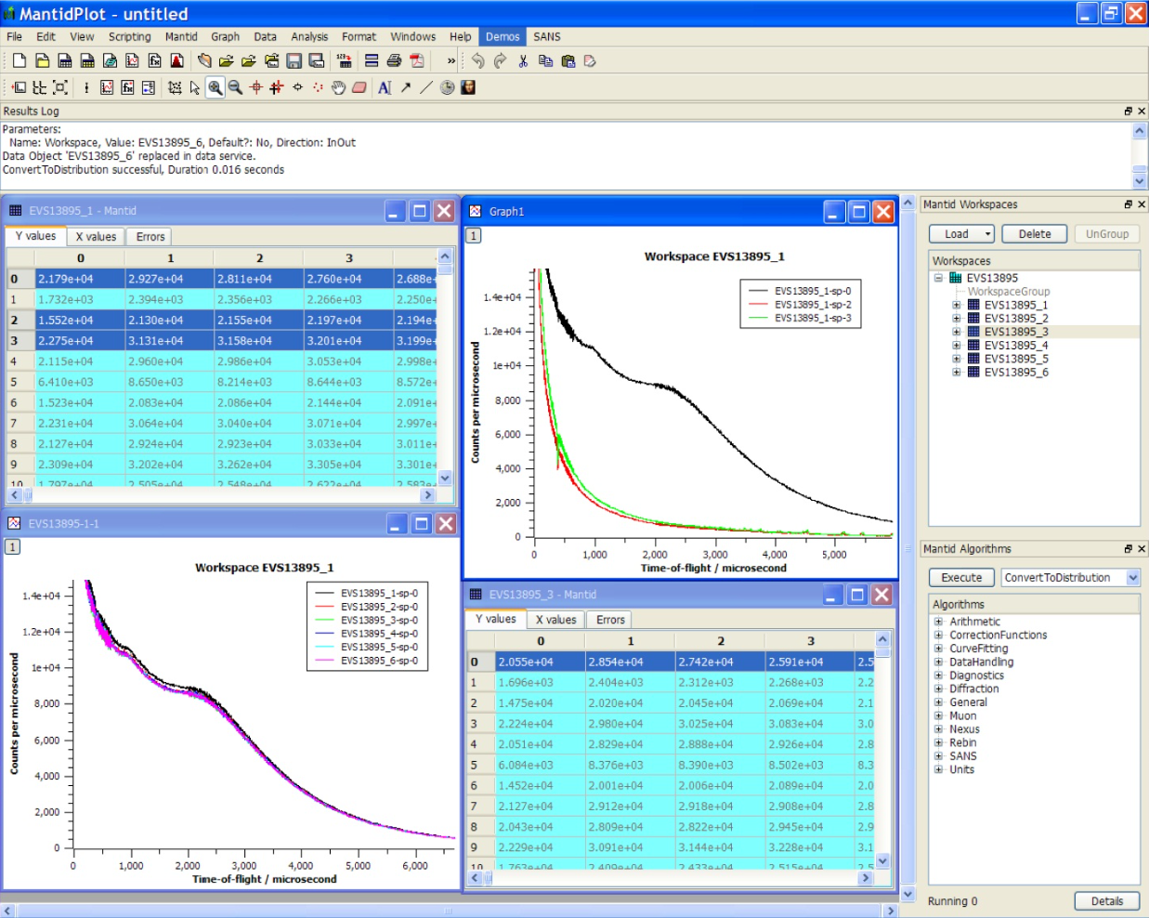
What we can do: MantidPlot

Slide 9
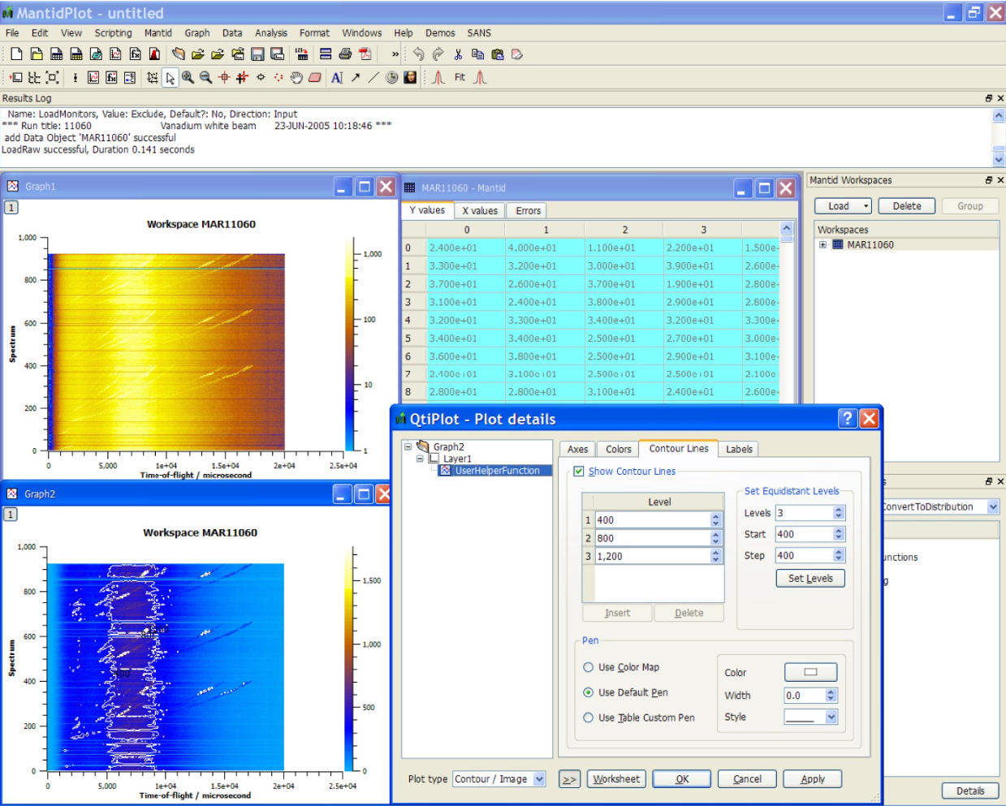
What we can do: MantidPlot

Slide 10
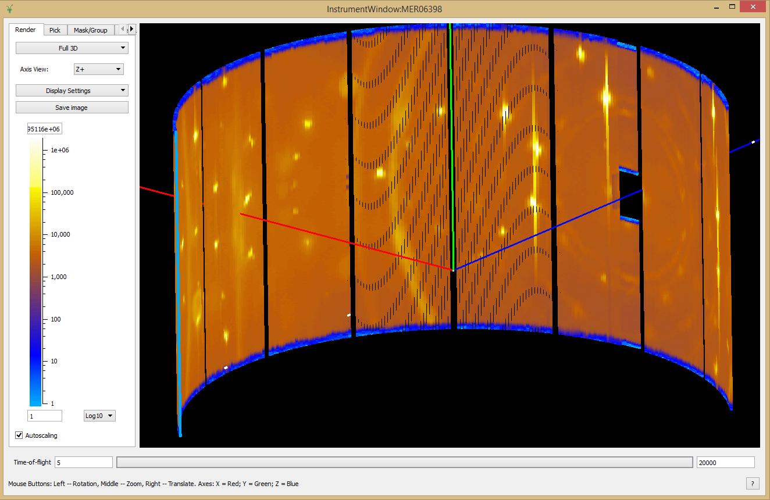
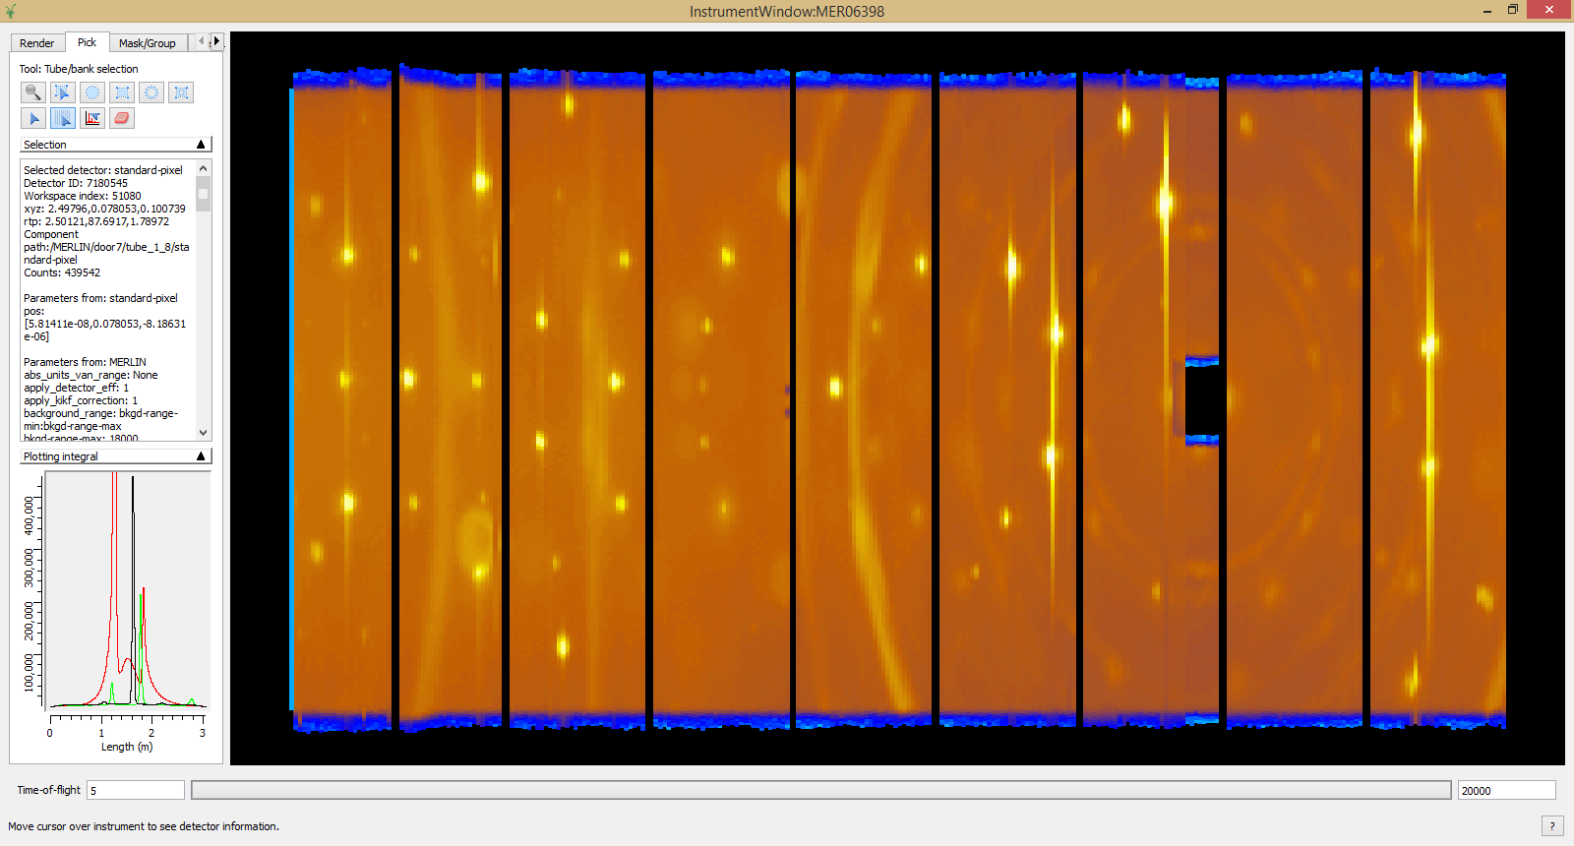
What we can do: Instrument View
Unwrapped 2D View
3D View

Slide 11
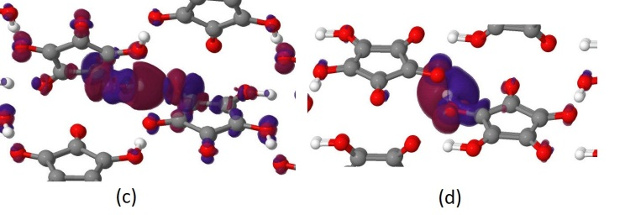
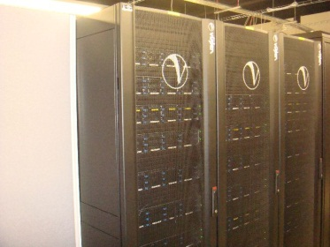
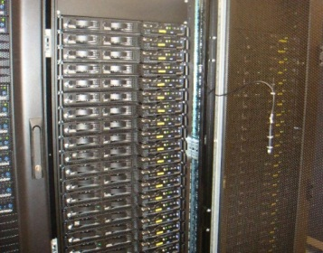
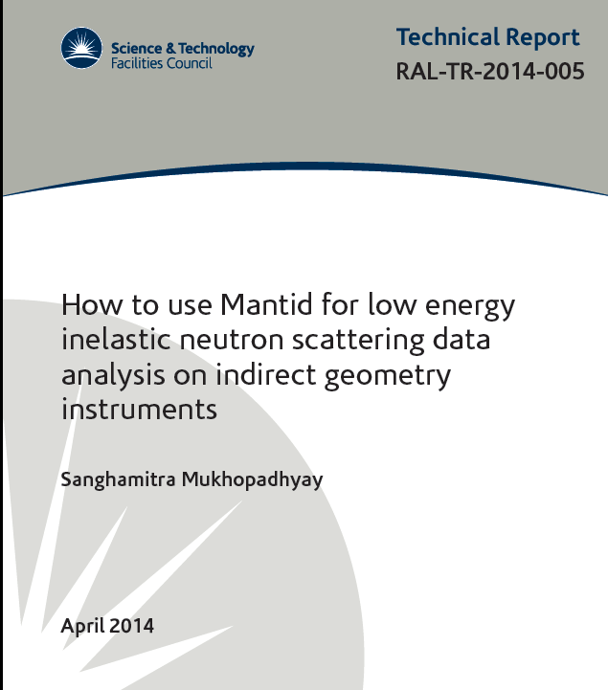
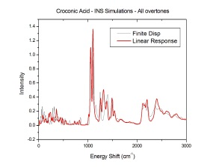
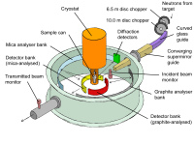
Data Interpretation in Mantid: Materials Modelling
Materials Modelling
e.g. (CASTEP, VASP, DLPOLY)
1548 processors on SCARF-RAL for Materials modelling
Ω
nMoldyn
Python Wrapper
Experiments
MANTID
Notes:
ARCHER (Edinburgh; apply ‘beam time’!)
nMoldyn (looked after by Mark Johnson at ILL): molecular dynamics calculations (CASTEP,: 512 atoms or 348 on SCARF) ; ViennaAbinitioSimulationProgram, DLPOLY 10^3 – 10^4 on ARCHER) and produces the outputs
e.g. Zeolite + water: melt the water (in the computer), follow trajectories into the zeolite => compute anything e.g. diffusion contants, correlation fuctions, MSQ, S(Q,w)….
Have written the python wrapper

Slide 12
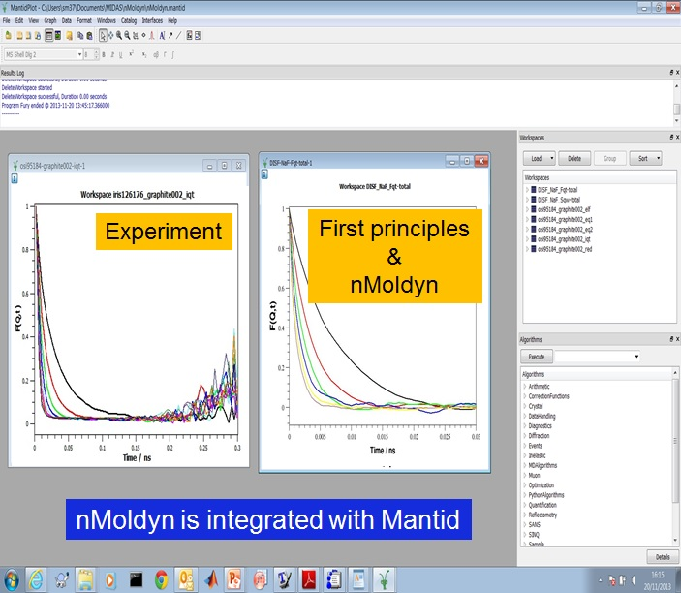
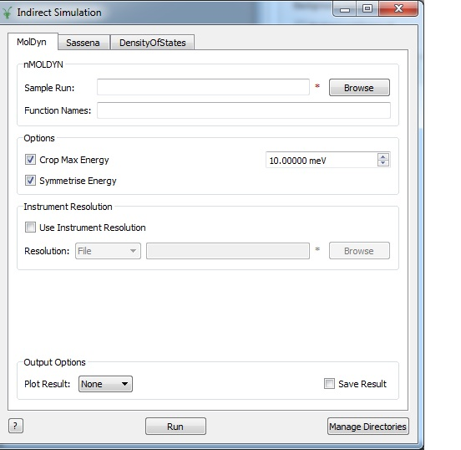
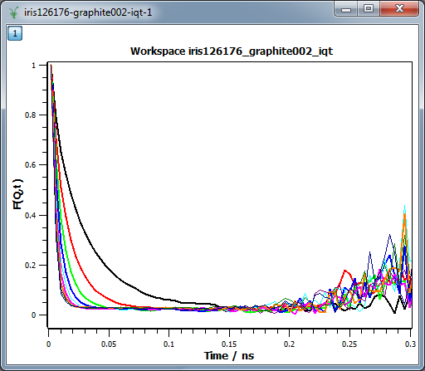
Data Interpretation: First Principles Simulation
Indirect Simulations interface
Experiment
Notes:
The data is from NaF molten salts at 1300K. At different Q i.e. I(Q,t)
The limitations in the simulations are small cell size (512 atoms) and small time scale (50ps)
The limitations in the experiment are instrument resolution and finite dynamic range.

Slide 13
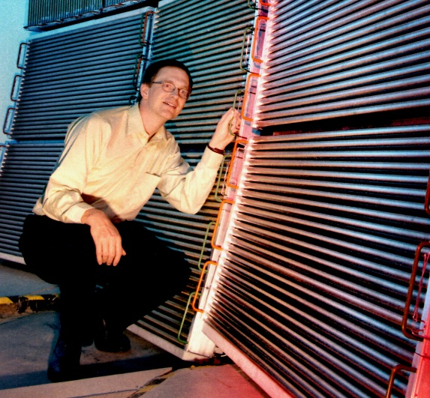
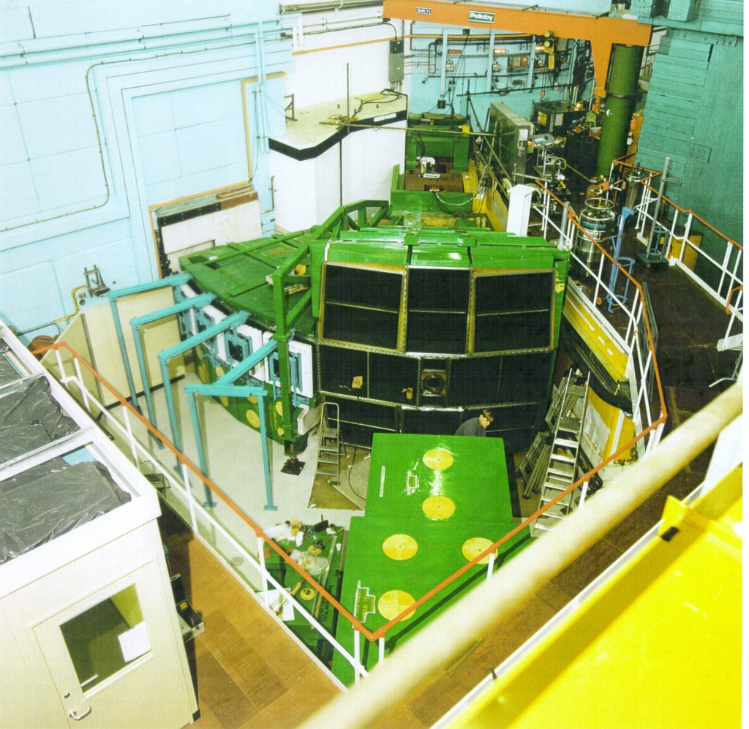
Direct Geometry
~10⁵ detector elements
~500 energy bins
100-500 runs
➔ 10¹⁰ voxels
MAPS spectrometer (ISIS)

Slide 14
Multi-dimensional data visualisation: Objectives
Represent n-dimensional data in the complete manifold of interest
Efficiently handle sparse as well as dense n-dimensional data
Operate on such data very quickly and also use Mantid’s plugin framework to add new algorithm features
Visualize massive data sets in n-dimensions
Have these tools work for more than just one technique area
Simulation and fitting
Notes:
A summary of the high-level objectives for the VATES (Visualization and Analysis Toolkit ExtensionS) Project. Now fully integrated into and indistinguishable from Mantid.
This subproject is an ongoing effort and collaboration between ISIS/SNS and ESS.

Slide 15
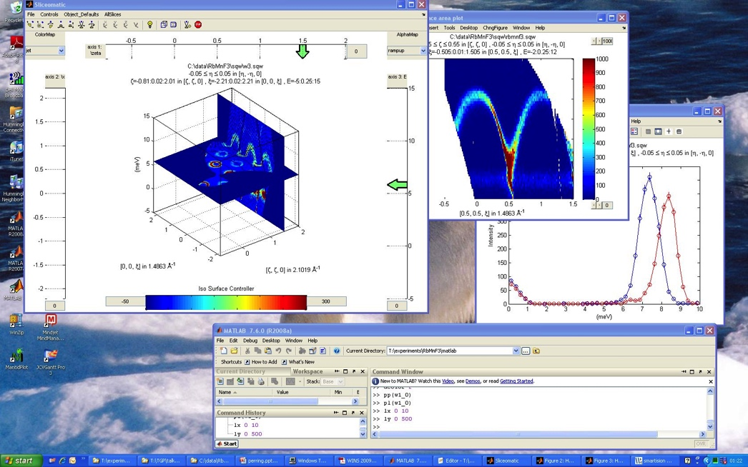
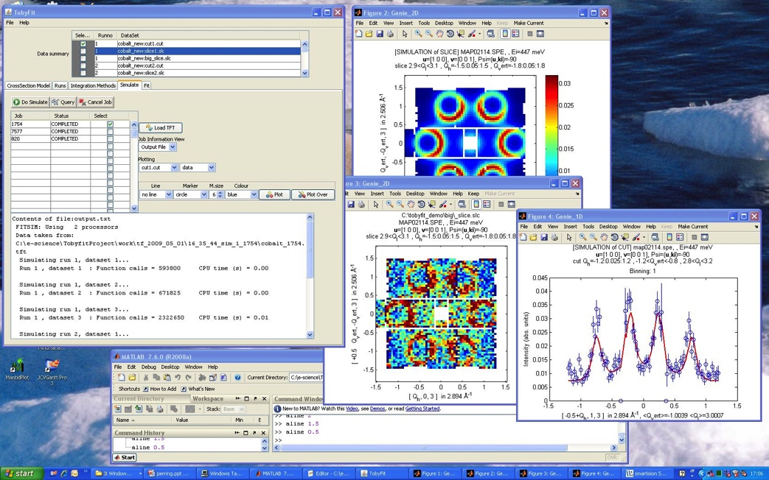
Seeding projects
Visualization
Horace
Dave
MSlice
ISAW
Quantification
Tobyfit
Notes:
This is not a project in a vacuum. Lots of prototyping and seeking of knowledge and experience from previous projects. As well as emulating successful features, we have tried to learn from mistakes. Having a diverse and multi-disciplinary development team with direct access to instrument scientists is key.

Slide 16
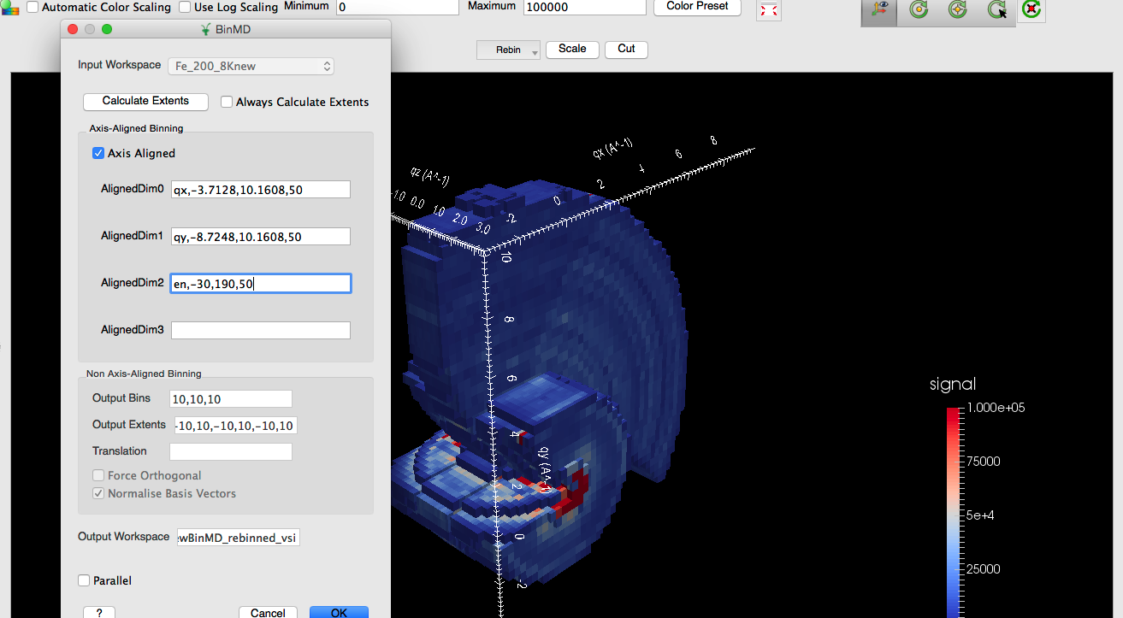
In-situ Rebinning
Notes:
Taking a 4D SQW dataset and integrating, out the qz dimension, and mapping delta energy to the y direction.
Omitting a dimension is equivalent to integrating it out for BinMD. We also have a Horace style CutMD available from the Rebin drop down as well as the pixel-preserving SliceMD.

Slide 17
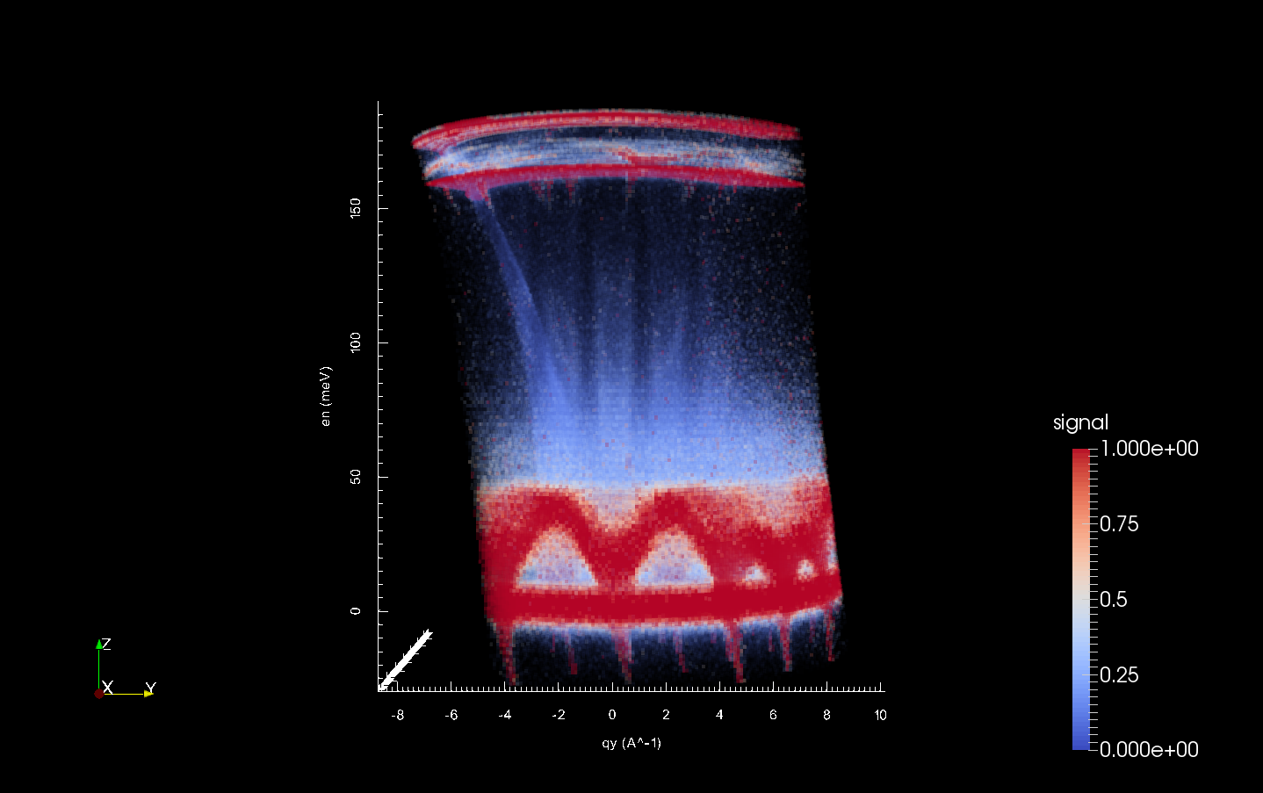
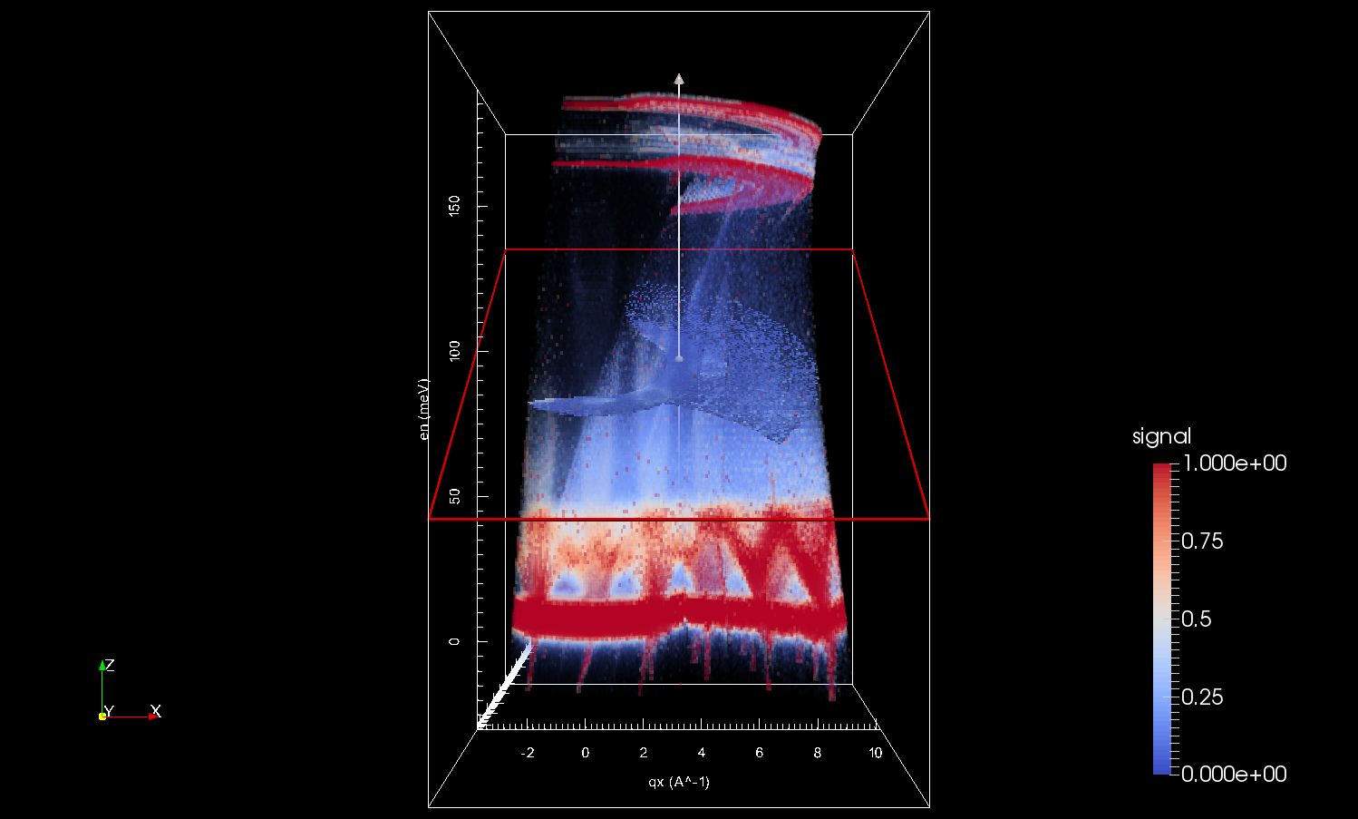
nD Visualisation
Fe 200Ei 8K
Notes:
Reduced data sets from multiple scans merged into a single multidimensional dataset. One reciprocal space dimension integrated out and visualized volume projection. All dimensions then rebinned uniformly inside the visualization window. All done in the Mantid application. No external tools needed. 28GB on disk but interactively visualized in 16GB RAM due to a large number of tricks and optimizations implemented in Mantid. We can also represent a 4th dimension on the time axis if we wish.

Slide 18
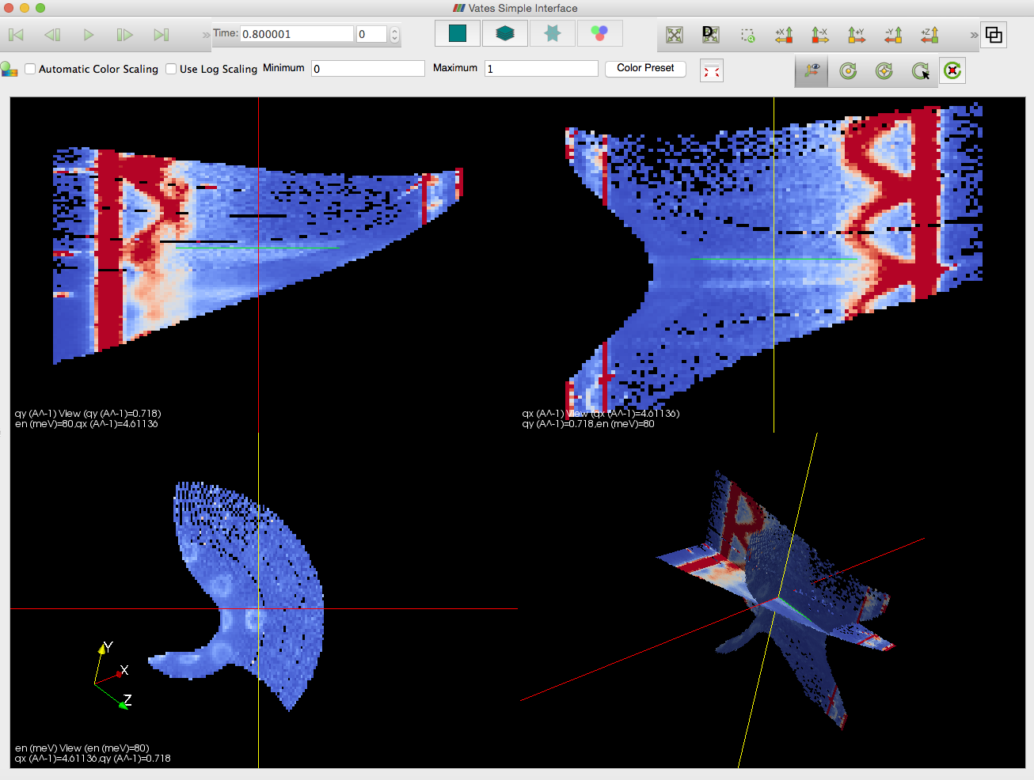
Switching to Three-Slice View
Notes:
Customized views allow us to view the data in various ways. We can switch between views at will. Here 3 orthonormal slices are created and can be moved independently.

Slide 19
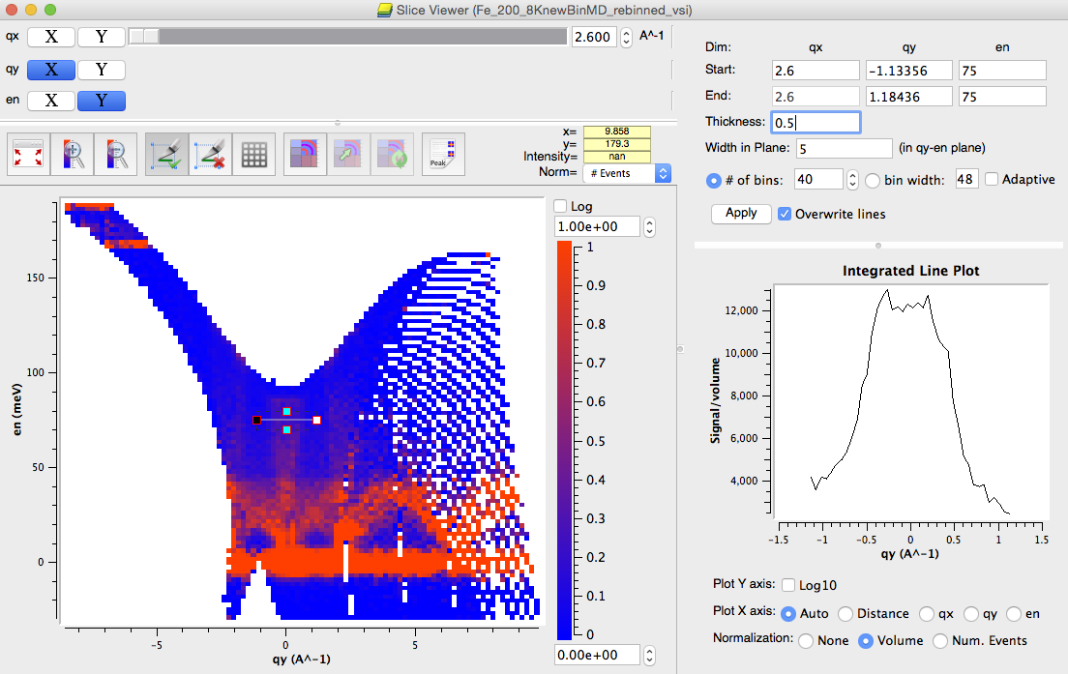
2D Slicing and Plotting
Notes:
Our 2D slice viewer has several very powerful inbuilt tools. One for which is the line viewer mode. So we can further reduce our data down to 1 dimension. Further rebinning may be performed to improve statistics.

Slide 20
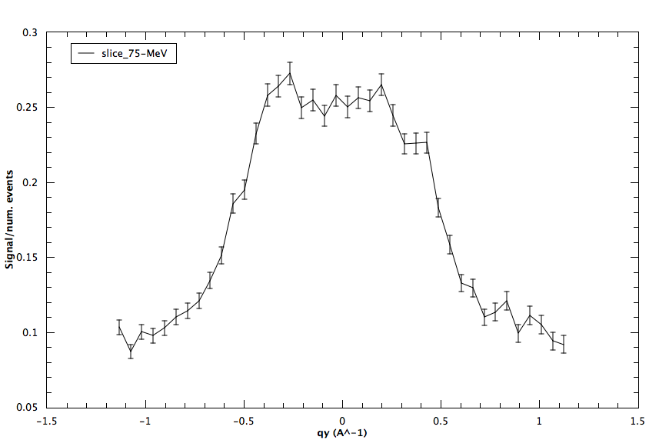
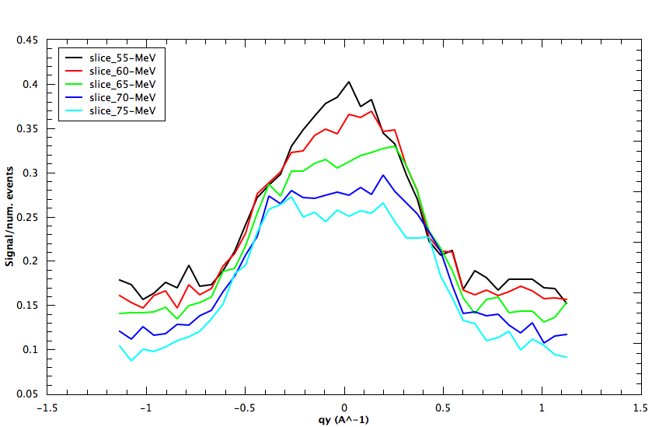
1D Plot
Notes:
Easy to programmatically or graphically move our line cut to other positions and overlay the results. The following plots have been created from the 2D slice above.

Slide 21
Large File Accumulation
Time
Run 1
Run 2
Run 3
Run N
N > 100
Combine
Notes:
Beam time is money. During cycle operation the instruments run 24/7. Typical cost of a 3-day experiment on a single instrument is 100K
This is the way the inelastic instruments where operating last summer.

Slide 22
Large File Accumulation
Time
Run 1
Run 2
Run 3
Run N
N > 100
Combine
Time out. Experimental ended
Notes:
Combine step taking too long. Scaling badly with number of runs.
Time penalty is REAL problem

Slide 23
Phase 1: Low-level Approach
Reduce the ‘combine’ time
Deep understanding of c/c++ memory model
Combine
Old: 4 hrs
Combine
New: 1 hrs
Notes:
Engineering approach
Measure, benchmark and optimize. Not the approach adopted by our client’s developers.
Boiled down to a bad allocation strategy
A single problematic line of code
75% reduction in time
3.5 hours of beam time for combination of 460 runs. That's saved 14K per experiment.

Slide 24
Phase 1: Large File Accumulation
Time
Run 1
Run 2
Run 3
Run N
N > 100
Combine
Notes:
…
Do we stop there?
But we can do better

Slide 25
Phase 2: High-level Approach
Time
Run 1
Run 2
Run 3
Run N
N > 100
Combine
Notes:
Before Mantid came across this was the way that things where done. And it’s tended to affect the way that people think about these sorts of problems.
Moving the Mantid gave us the opportunity to reorganize the problem.
Change in the accepted procedure

Slide 26
Phase 2: High-level Approach
Time
Run 1
Run 2
Run 3
Run N
N > 100
Notes:
- High-level parallel workflow. Complements the low-level work already done.
Combination/accumulation is done piecewise as and when the new processed runs become available.
- What’s more users can start evaluating the data as it’s been accumulated.
Give the option give the option to stop the experiment
Rescan angles
Swap sample
Increment addition of runs as the experiment goes ahead. Not only faster at the end of the experiment, but during the experiment.

Slide 27

Future Tasks
Multiple Scattering Corrections
Better integration with Third Party simulation codes
VASP, Gaussian, CASTEP, McPhase, SpinW/Spinwavegenie etc
Common Language - ASE
- Simulation first, Optimisation later
Better use of facility / cloud resources
- Remote desktop – Performance and stability
- Client server Mantid
- Web based UI
- Parallel visualisation rendering

